Slide 1
An Extended Two-Dimensional Vocal Tract Model For Fast Acoustic Simulation Of Single-Axis Symmetric Three-Dimensional Tubes
Debasish Ray Mohapatra¹, Victor Zappi², Sidney Fels¹
¹Human Communication Technologies Lab, The University of British Columbia
²College of Arts, Media and Design, Northeastern University
Notes:
Hello Everyone. Welcome to my talk. I am Deb and a second year master student at the University of British Columbia.
In this presentation I would like to introduce a new vocal tract model that might help us in designing a real-time articulatory speech synthesis.

Slide 2
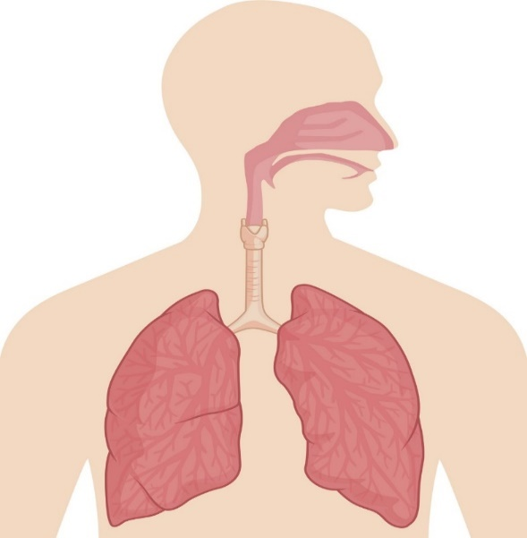
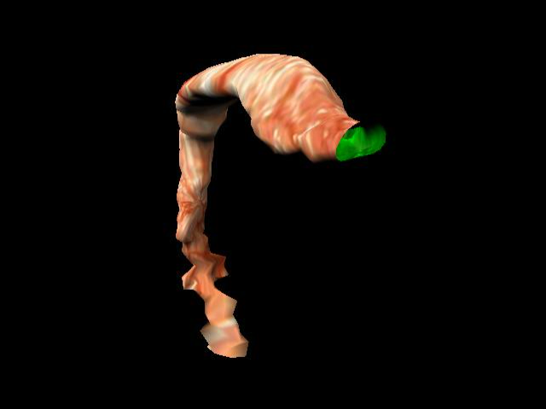
Fundamental Components In Articulatory Vocal Synthesis
Source Model - Vocal Fold
Filter Model - Upper Vocal Tract
Coupling of Vocal fold & Vocal tract
Notes:
Human speech system is quite complex. And we could analyse it both from physiological as well as acoustic prospective. As our research is focused towards articulatory vocal synthesis, we want to understand and model the intricate structures of human speech anatomy and the acoustic physics behind it.
The articulatory speech synthesis can be divided into three fundamental components…….
(click)And today I will be talking about the modelling of the upper vocal tract/filter model.

Slide 3
Research Objectives
Presenting a new vocal tract model (2.5D) that targets:
Precision: Precise simulation of formants of realistic vocal tract
Time Performance: Computationally light-weight model which could achieve real-time/quasi real-time performance
Notes:
While designing our new vocal tract (which we have named as 2.5D) we have aimed for two research objectives…..
You might think, why should we go for a new VT design when there are few realistic vocal tract models already exist in literature and why are we targeting these two objectives?
To answer that I would like to do a short review of the existing models.

Slide 4
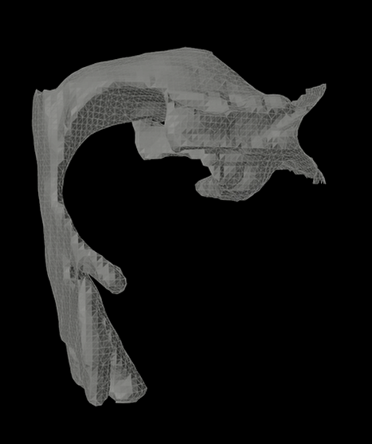
3D Vocal Tract Model
Advantage:
Simulate airwaves propagation inside the realistic vocal tract geometry
Produce very precise results
Drawbacks:
Simulation is extremely slow - Requires several hours to simulate few milliseconds of audio
Not convenient for many applications like clinical research or designing singing synthesis
Marc Arnela,“Numerical production of vowels and diphthongs using finite element methods”, 2016
Notes:
Out of all the models that exist in current literature, the 3D models can simulate the airwaves propagation inside the realistic vocal tract geometry and produce very precise result in terms of formant position and bandwidth same as the modeled vocal tract. Here, one of the key example could be Marc Arnela’s work which is a 3D FEM model
But one of the major drawback in 3D models is the time complexity. Because the simulation of 3D models are extremely slow, it requires several hours of simulation just to produce few milliseconds of audio
Given the fact that it computationally expensive, these techniques might not be convenient for clinical research where we need to simulate different vocal tract structures multiple times. Or this model might not fit for designing a real-time singing synthesis

Slide 5
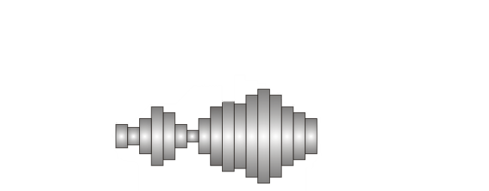
1D Vocal Tract Model
Advantage:
Simulate acoustic wave propagation in 1D
1D models are computationally much faster and can be simulated in real-time.
Drawbacks:
Oversimplified representation of the actual vocal tract geometry
Model can correctly simulate the formants up to 5kHz
http://www.vocaltractlab.de/index.php?page=background-articulatory-synthesis
Notes:
Now to overcome the time complexity issue of 3D models, we can approach for 1D models. These model simulate acoustic wave propagation in 1D. And due to the reduction in dimensionality, 1D models are computationally much faster and simulate in real time. One example could be Birkholtz’s parametric model.
But 1D models are over simplified representation of the actual complex vocal tract structure. And the model could only able to provide formants correctly upto 5kHz.

Slide 6
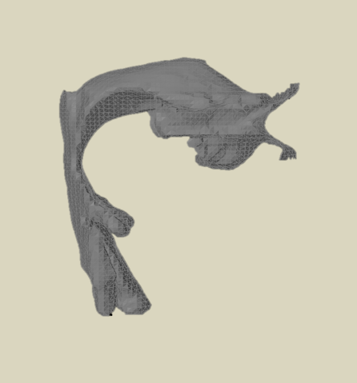
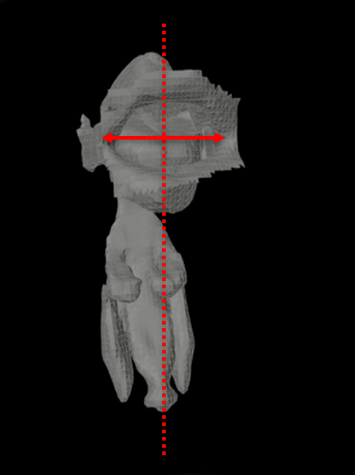

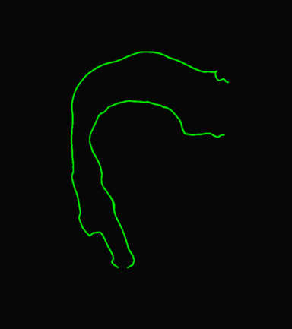
2.5D – An Extension Of 2D
2D Representation
Inclusion of Depth for 2.5D
Depth across mid-sagittal plane
Zappi et al.,“Towards real-time two-dimensional wave propagation for articulatory speech synthesis”, 2016
Notes:
And these constraints of 3D and 1D vocal tract models, motivate us for a new approach i.e. 2.5D vocal tract model. This model is the extension of the 2D FDTD model by Zappi et al in the below article.
If we’ll consider 2D vocal tract, it’s the mid-sagittal slice of a 3D tube built from it’s area function. Or in another way, we can say that the 2D vocal tract is represented just by a flat contour.
And at the core of 2.5D approach, we have included another geometrical feature (also known as tube’s depth) to our 2D model as an extra impedance term. This depth could be described as the height of the tube across the mid-sagittal plane.

Slide 7
2D FDTD – Acoustic Parameters Representation
Yee Grid Representation
v_{y}
p
v_{x}
Notes:
Before demonstrating how do we map the tube depth, to the existing 2D FDTD model, I would like to give a brief overview to the method which represents various acoustic parameters while using finite difference time domain (FDTD) technique:
First, we used a Yee-grid representation to define the acoustic parameters (also known as pressure and velocity fields).
Secondly for each grid cell, we defined the pressure component at the centre of the grid & velocity components Vx and Vy at the mid-point of the edges the grid.
At each time step we computed all three components (p, vx and vy) for every grid cells
While evaluating present value of an acoustic parameter at a certain time-step for a grid-cell, we used the top neighbor cell (red one) and right neighbor cell (blue one), next to the current cell.

Slide 8

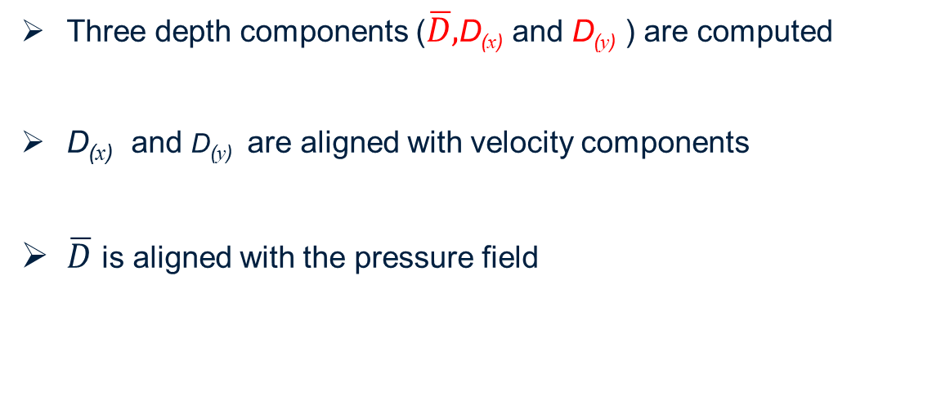




2.5D – Depth Representation
v_{y}
$$\text{D}\text{(}\text{y}\text{)}$$
p
$$\text{D}\text{(}\text{x}\text{)}$$
Three depth components ($\overline{D},$D_{(x)} and D_{(y)} ) are computed
D_{(x)} and D_{(y)} are aligned with velocity components
$\overline{D}$ is aligned with the pressure field
$$\overline{D}$$
v_{x}
$$\text{D}\text{(}\text{y}\text{)}$$
$$\text{D}\text{(}\text{x}\text{)}$$
Notes:
As now we have a general representation of 2D, let’s switch to 2.5D approach: So we’ll be using same 2D Yee-Grid representation with an extra component i.e. depth
As now we have three acoustic parameters, we have calculated corresponding three depth components: D bar, Dx and Dy
Each of those depth component will be aligned with their respective acoustic parameters. So, for example:…(as shown in the upper figure)
Now if we’ll look at all these depth components from a side-view: It’ll look something like this: The solid line represents depthX and the dotted lines depthY

Slide 9
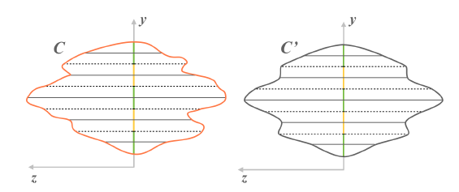
2.5D – Depth Representation
Single-Axis Symmetrical Representation
Depth map introduces a single-axis symmetry
Curvature is preserved and most of the cross sectional details
Notes:
But, here is a fact that I would like to highlight:
1. The depth map introduces a slight variation in the cross-sectional shapes of the original tube geometry. So if there is an irregular cross-sectional shape as shown in the left side of the figure, then the cross-sectional shape will be slightly modulated to have single-axis symmetry keeping it’s cross-sectional area intact. Which means 2.5D FDTD is capable of simulating how pressure propagates in 3D geometries that are symmetric at least in direction, typically along the z-axis.
2. Because of the change in the cross-sectional shape to the tube geometry, there might be a slight variation in the acoustic between 3D and 2.5D. But model still captures the most of the cross-sectional details

Slide 10
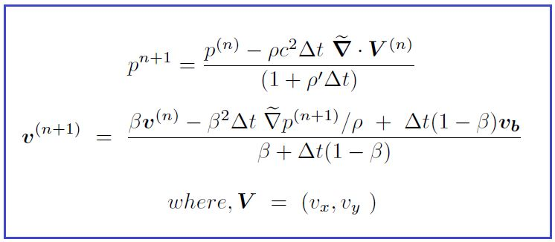
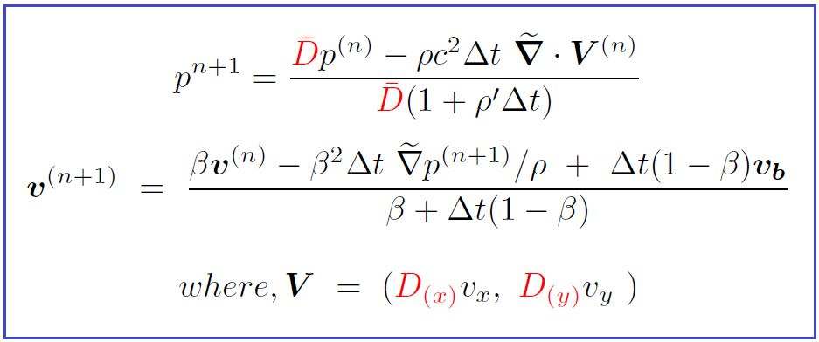
2.5D – Wave Solver Equation
Notes:
To compute acoustic parameters inside the grid, we first discretized the acoustic wave equation. Here is the discretized wave solver equation for the 2D FDTD. To design 2.5D acoustic wave solver equation, the depth parameters are just mapped to their respective acoustic parameters keeping rest of the equation same.

Slide 11
2.5D – Model Validation
Used Story’s area-function to construct the vocal tract geometry
2.5D FDTD acoustic wave solver was implemented in MATLAB environment
The grid resolution was set to the best possible
minimum value.
2D FDTD (same simulation parameters as 2.5D)
for time performance comparison.
Mid-sagittal contour and depth map for vowel /a/
B.H. Story,“Comparison of magnetic resonance imaging-based vocal tract area functions obtained from the same speaker
in 1994 and 2002”, 2008
Notes:
1. For model assessment, first we constructed 3D tubes for static vowels like: /a/, /i/, and /u/ using Story’s area function. This
dataset defines a standard in vocal tracts’ acoustic analysis and has been used by many researchers for vocal tract modelling. And it also ideal to work with circular cross-section. The image here shows the discretized tube construction for the vowel sound /a/ from the cross-sectional area function.
2. A band-pass filter function was placed at the start of the tube as an acoustic source and a mic was kept near the end of the tube to record the audio spectrum.
2. For simulation purpose, we implemented the model in MATLAB environment. For a faster simulation, the grid resolution was set to the best possible minimum value which could still preserve the geometrical details of the vocal tract
3. We also simulated a standard symmetric 2D FDTD wave solver as demonstrated by Zappi et al. in MATLAB environment with a low grid resolution just like 2.5D. The motive behind this was to compare and understand the time performance of our new model due to the inclusion depth terms. But I would like to recall that, with such a low grid resolution 2D vocal tract does not provide a precise formants.

Slide 12
Simulation Result – Precision
Comparison with slow but precise 3D FEM for static vowel sounds /a/, /i/, /u/
Percentage error in terms of formant positions
Formants | /a/ | /i/ | /u/
f1 | 0.57 | -1.14 | 0.38
f2 | -2.62 | 2.32 | -4.88
f3 | -0.36 | 1.66 | 1.59
f4 | 1.37 | 1.98 | 0.47
f5 | -1.17 | 0.01 | 2.56
f6 | -0.40 | -0.22 | -2.01
f7 | -0.07 | -1.44 | -0.75
f8 | 0.32 | 0.45 | 0.39
Marc Arnela,“Numerical production of vowels and diphthongs using finite element methods”, 2016
Notes:
So here is our simulation result in terms of precision:
As Arnela’s 3D FEM model can construct the complex vocal tract geometry and compute the formants quite precisely, we used that as a reference to evaluate our first research objective. The table here, shows the relative percentage error in terms of formants position between 2.5D FDTD and 3D FEM vocal tract model for three different static vowel sounds.
Those with green color have relatively very low percentage error (below 1%) in terms of formant position and almost equivalent with the 3D FEM model. The blue ones have percentage error above 1%. And we can see here that the higher formants have still a very low percentage error across all the three vowels

Slide 13
Simulation Result – Time Performance
Comparison with fast but unprecise 2D FDTD model
MATLAB implementation of 2.5D FDTD proves to be extremely lightweight
Both 2D and 2.5D models showcased a comparable time complexity
(around 15 mins to produce 50 milli-seconds of audio)
A highly optimized parallel implementation for the 2D FDTD model in GPU has already been proven to be quasi real-time in terms of time complexity.
Notes:
And this shows the simulation result in terms of performance:

Slide 14
Discussion & Model Limitation
2.5D VT model is as precise as 3D model in a simple scenario. And it has the potential to run close to real-time.
The model needs to be tested in more complex scenario
Losses are only modeled across the 2D contour but not along z-axis
Notes:
1. 2.5D is almost as precise as 3D model in a simple scenario and light weight , Has the potential to run close to real-time as our experiment shows
2. This point model needs to be tested in more complex scenario i.e tube with bend, with realistic irregular cross-section. To test how the introduction of a forced symmetry constraint will affect the precision of the model.
3. At this stage of the development, losses are only modeled along the 2D contour but not along z-axis or around the tube depth. This prevents us from simulating realistic cross-section for now.

Slide 15
Future Work
Test the precision of the model while simulating bent tube with circular cross-sections
Add boundary condition to test irregular cross-sections.
Implementing the model using GPU to target real-time simulation

Slide 16

THANK YOU

Slide 17
Questions Please

